Slide 1
CSE 2451 Array
Tong Liang

Slide 2
Overview
Array
Constant length array
Variable length array
Unknown size
Initialization
Subscripting / indexing
Implicit conversion: array decays to a pointer
Pointer arithmetic
Array as input to function
Multiple dimension array
Valid main function

Slide 3
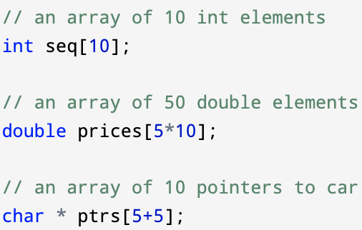
Array – of constant known size
Store a sequence of objects of the same type contiguously in memory
Format: type identifier[expression];
Array size:
Integer constant expression,
specifies the number of objects stored in the array

Slide 4
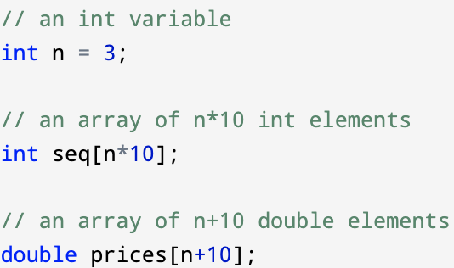
Array – of variable length (since C99)
If expression is not an integer constant expression, the declaration is for an array of variable size
Format: type identifier[expression];
Array size:
Not an integer constant expression
Variable-length arrays (VLA) and the types derived from them may only be declared at block scope or function prototype scope

Slide 5
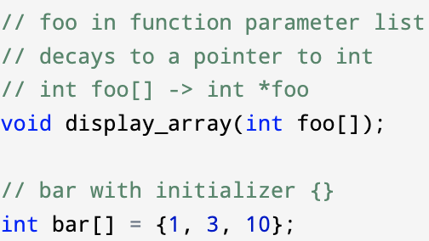
Array – of unknown size
If expression in an array declaration is omitted, it declares an array of unknown size. Except (1) in function parameter lists (2) when an initializer is available
Format: type identifier[expression];
Type of foo: a pointer to int, not an array of unknown size
Type of bar: array of 3 int, not an array of unknown size

Slide 6
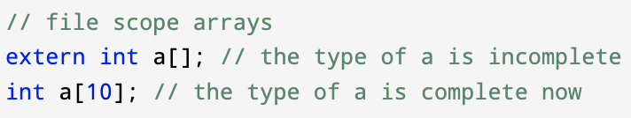
Array – of unknown size
If expression in an array declaration is omitted, it declares an array of unknown size. Except (1) in function parameter lists (2) when an initializer is available
Format: type identifier[expression];

Slide 7
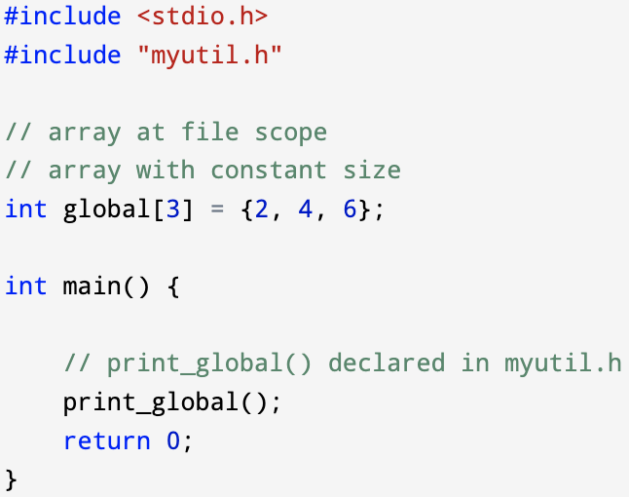
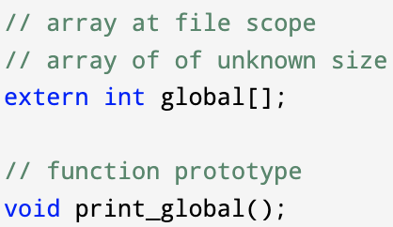
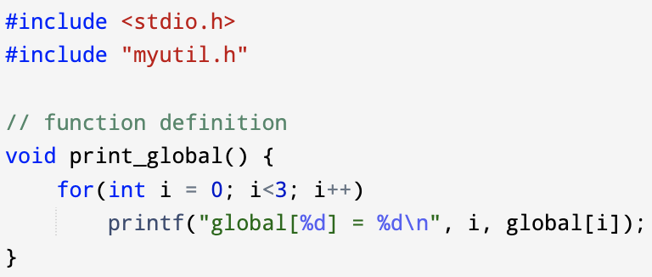
Array – of unknown size – example
If expression in an array declaration is omitted, it declares an array of unknown size. Except (1) in function parameter lists (2) when an initializer is available
Format: type identifier[expression];
main.c
myutil.h
myutil.c

Slide 8
Array – initialization
When initializing an object of array type, the initializer must be either a string literal or be a brace-enclosed list of expression for array members
= string-literal
only for array of char type
= {expression, …}
expression can be constant or other type of expressions
= {[constant-expression]=expression, …}
constant-expression in [] specifies with element in the array to initialize
= {}
Empty initialize, every element in the array is set to 0
Variable length array may not be initialized (C99)
You can assign value to its element one by one, but not initialize the whole array directly with array initialization

Slide 9
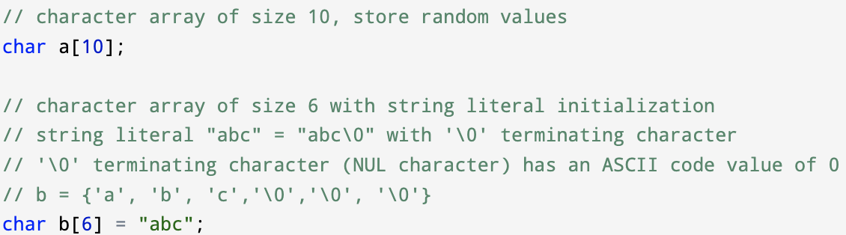
Array – initialization – example
= string-literal
There will be a ’\0’ character/escape sequence padded to the end of your string literal

Slide 10
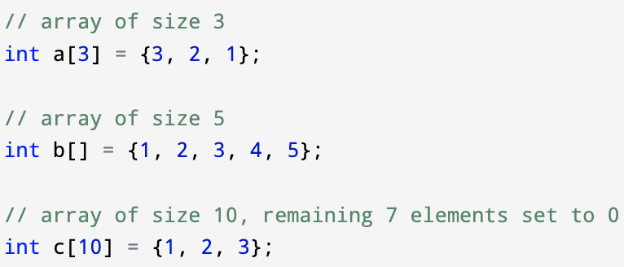
Array – initialization – example
={expression, …}

Slide 11
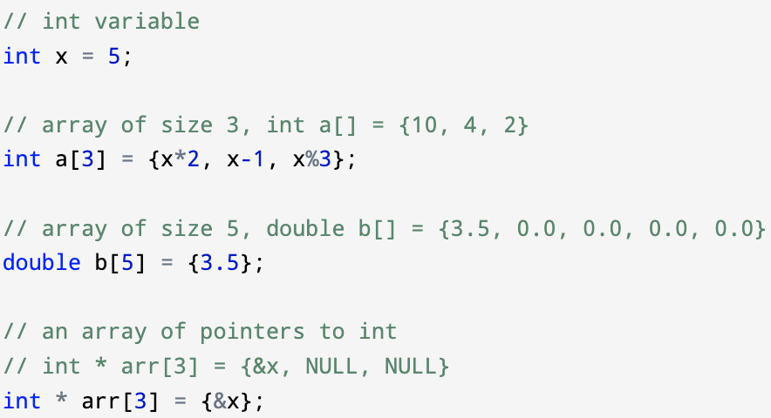
Array – initialization – example
={expression, …}

Slide 12
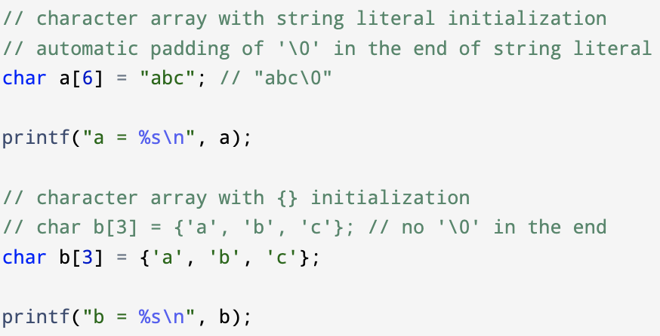

Array – character array initialization
String literal initialization vs {expr, …} initialization for character array
C-style string ⊊ character array
Valid C-style string always terminates with a ‘\0’ character
Use %s as format specifier for a C-style string
Character array without ‘\0’ as its last element is not a valid C-style string, it’s just a character array

Slide 13
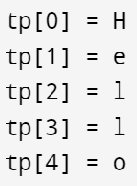
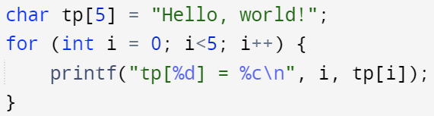
Array – character array initialization
If the size of the array is known, and it’s shorter than the size of the string literal, the remaining characters in the string will be ignored, including the ‘\0’ in the end

Slide 14
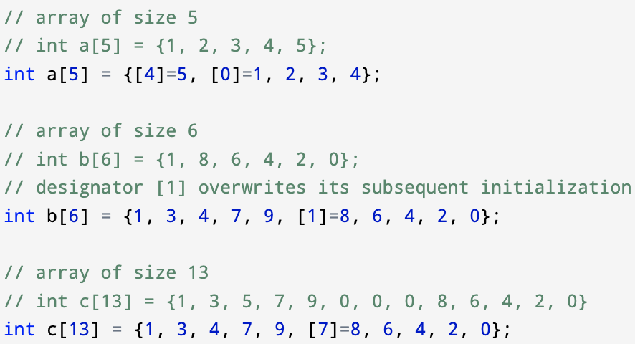

Array – initialization – example
= {[constant-expression]=expression, …}
When initializing an array of unknown size, the largest subscript for which an initializer is specified determines the number of elements of the array being declared
Subscript 15 is valid in an array of a minimum size of 16
Number of elements of int foo[] is 16

Slide 15
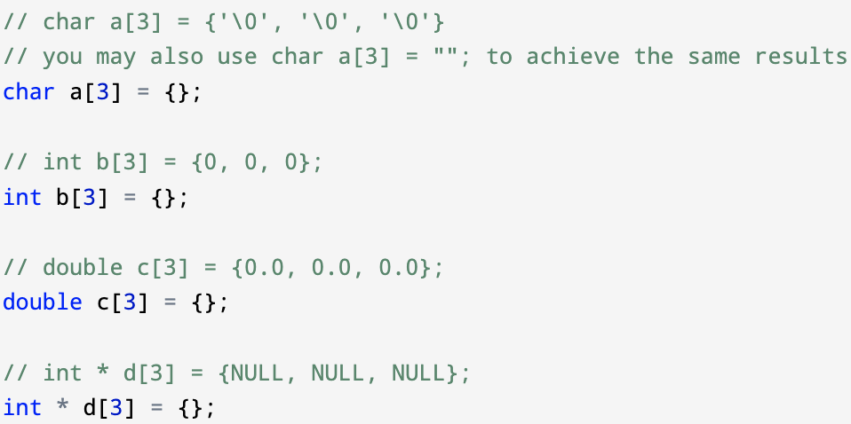
Array – initialization - example
={}, set every element in the array to zero (‘\0’ for char, 0 for int, 0.0 for floats, NULL for pointers)
={} only works with array of constant size

Slide 16
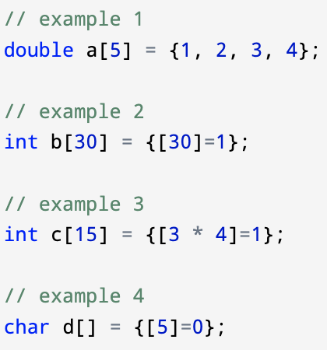
Array – example
Are the following array initializations correct?
Notes:
Example 2 are incorrect

Slide 17
Array – indexing
Array can be indexed with [] (array subscripting operator)
Format: arrayName[expression]
arrayName is the identifier of the array
expression must evaluate to an integer value within the valid index range
The value of expression is referred as the subscript/index
Indicates which element in the array you’re indexing for
C is 0-based indexing, i.e., its array’s index starts from 0 (1-based indexing: Matlab)
Valid index range of an array with size N: integer within range of [0, N-1]
Out-of-bound indexing of an array is undefined behavior

Slide 18
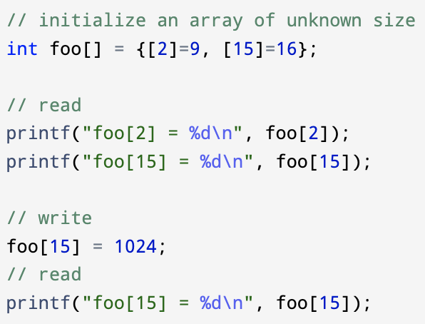
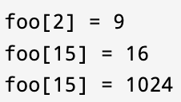
Array – indexing – example
Indexing an array gives you read/write access to the associated element

Slide 19
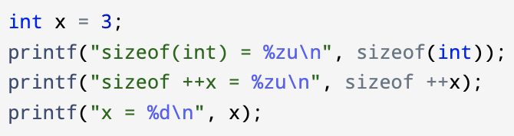
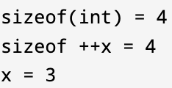
Array – sizeof operator
sizeof operator, syntax
sizeof is a compile time operator, it doesn’t evaluate its operand (expression)
sizeof returns the size of its operand in terms of number of bytes
sizeof return a non-negative integer value of size_t type
size_t is an unsigned integer type
used to represent size of an object
commonly used to declare variable for array indexing
Its range is guaranteed to be big enough to contain the size of the largest object the host system can handle
%zu is the format specifier for size_t values
You can print size_t type values with %d or %u but when the actual value stored in size_t typed variable exceeds the range of int or unsigned int, the printed value is not correct
sizeof (type)
sizeof expression
Notes:
Pointer arithmetics:
https://www.geeksforgeeks.org/pointer-arithmetics-in-c-with-examples/

Slide 20
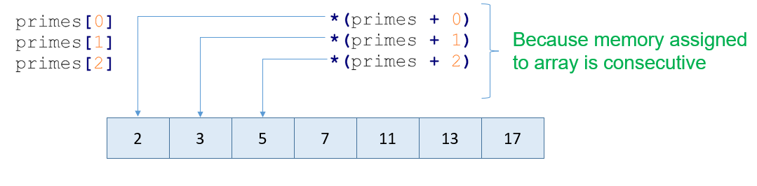
Array
Array in memory space (a contiguous chunk of memory):
primes[i] is syntactic sugar for *(primes + i)
Notes:
Pointer arithmetics:
https://www.geeksforgeeks.org/pointer-arithmetics-in-c-with-examples/
Pointer arithmetics with 2d array
https://stackoverflow.com/questions/14808908/pointer-to-2d-arrays-in-c

Slide 21
Array – implicit array to pointer conversion
You may notice the identifier of the array, i.e., primes acts as if it were a pointer
Implicit array to pointer conversion: an array’s identifier, when used in any context other than the following cases, implicitly converts to a pointer to its first element
As the operand of the & (address-of) operator
As the operand of sizeof operator
Notes:
String literal: stored as an unnamed object of specified character array type in-place
https://en.cppreference.com/w/c/language/string_literal
Is an array name a pointer?
https://stackoverflow.com/questions/1641957/is-an-array-name-a-pointer

Slide 22
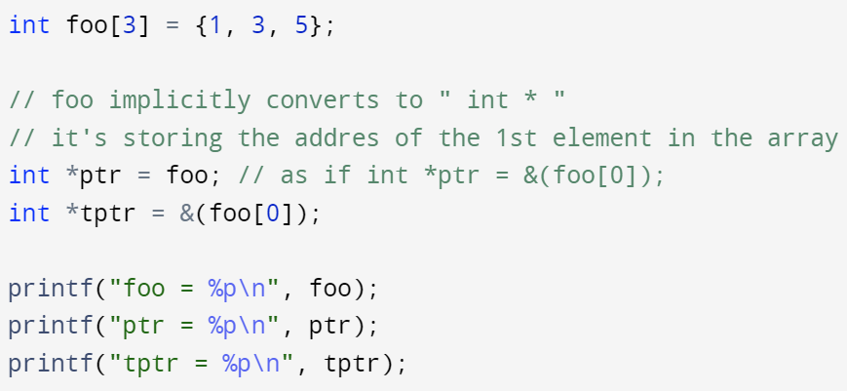
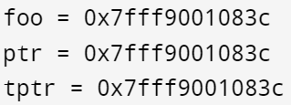
Array – implicit array to pointer conversion
Implicit array to pointer conversion: an array’s identifier, when used in any context other than the following cases, implicitly converts to a pointer to the array’s first element
As the operand of the & (address-of) operator
As the operand of sizeof operator
The array identifier foo is used in context outside of & and sizeof operator:
Int *ptr = foo; // foo is implicitly converted to a pointer to the foo array’s 1st element, i.e., (int *)
printf(“foo = %p\n”, foo); // again, foo is converted to (int *)
Notes:
String literal: stored as an unnamed object of specified character array type in-place
https://en.cppreference.com/w/c/language/string_literal
Is an array name a pointer?
https://stackoverflow.com/questions/1641957/is-an-array-name-a-pointer

Slide 23

Array – pointer/address arithmetic
A pointer in C is storing an address, which is a numeric value. Therefore, you can performance arithmetic operations on a pointer just as you can on a numeric value
There are 4 arithmetic operations you can apply to a pointer: ++, --, +, -
These operations change the address stored in the pointer with respect to the size (bytes) of the pointed object
Pointer arithmetic on void pointer is illegal in C
primes + 0 = 0x1004
primes + 1 = 0x1008
primes + 2 = 0x100c
$$c_{16}={12}_{10}$$
0x1004
0x1008
0x100c
Notes:
String literal: stored as an unnamed object of specified character array type in-place
https://en.cppreference.com/w/c/language/string_literal
Is an array name a pointer?
https://stackoverflow.com/questions/1641957/is-an-array-name-a-pointer
Void pointer arithmetic is illegal
https://stackoverflow.com/questions/3523145/pointer-arithmetic-for-void-pointer-in-c

Slide 24
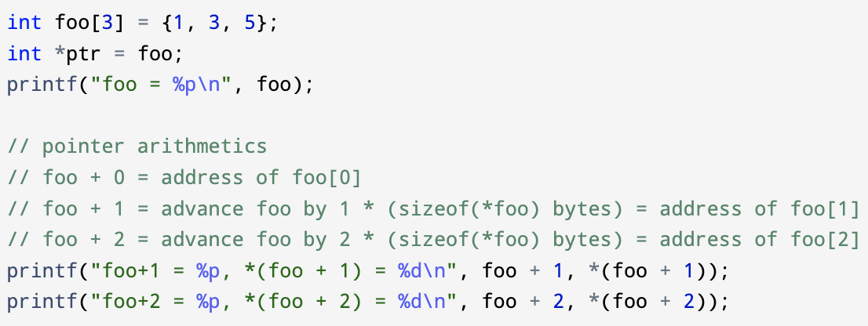
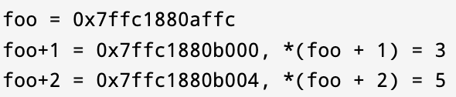
Array – pointer arithmetic
There are 4 arithmetic operations you can apply to a pointer: ++, --, +, -
These operations change the address stored in the pointer with respect to the size (bytes) of the pointed object
If the pointer is pointing to an object with size of t bytes, add ‘k’ to the pointer will increase the address stored in the pointer by k * t
Address difference between foo + 2 and foo + 1 is 4 bytes, i.e., one integer’s size, one element’s size in the foo array
Notes:
String literal: stored as an unnamed object of specified character array type in-place
https://en.cppreference.com/w/c/language/string_literal
Is an array name a pointer?
https://stackoverflow.com/questions/1641957/is-an-array-name-a-pointer

Slide 25
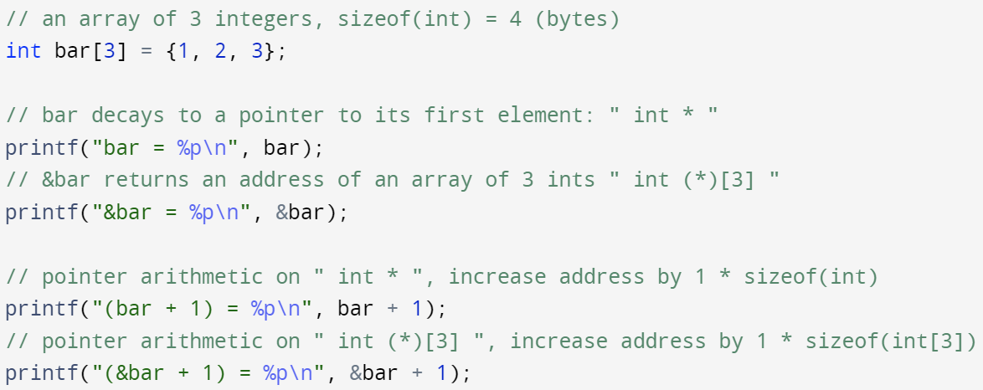
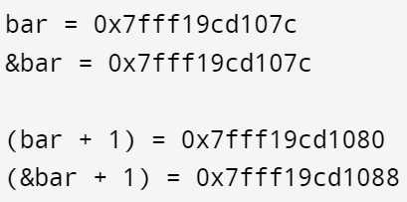
Array – apply address-of operator on array
Implicit array to pointer conversion: an array’s identifier, when used in any context other than the following cases, implicitly converts to a pointer to the array’s first element
As the operand of the & (address-of) operator
As the operand of sizeof operator
Apply & (address-of) operator is to an array’s identifier, it will return the address of the array’s first element as if the address is stored in a pointer to the array as a whole (no implicit conversion)
0xcd107c + 1 * sizeof(int) =
0xcd107c + 1 * 4 = 0xcd1080
0xcd107c + 1 * sizeof(int[3]) =
0xcd107c + 1 * 3 * 4 = 0xcd1088
Notes:
String literal: stored as an unnamed object of specified character array type in-place
https://en.cppreference.com/w/c/language/string_literal
Is an array name a pointer?
https://stackoverflow.com/questions/1641957/is-an-array-name-a-pointer

Slide 26
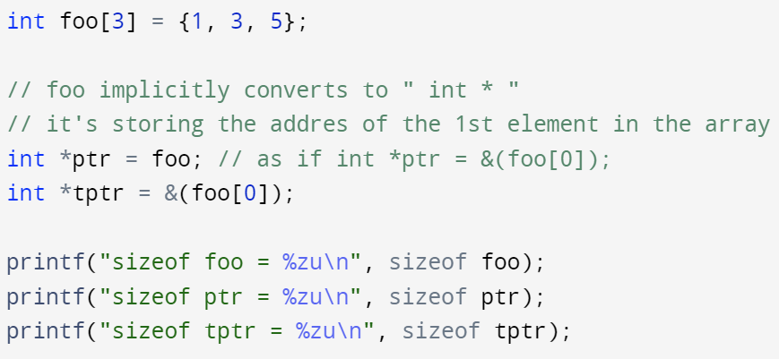
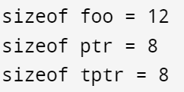
Array – apply sizeof operator on array
Implicit array to pointer conversion: an array’s identifier, when used in any context other than the following cases, implicitly converts to a pointer to the array’s first element
As the operand of the & (address-of) operator
As the operand of sizeof operator
Apply sizeof operator to an array’s identifier, it will return the number of bytes the array occupies in memory (no conversion to pointer, therefore not returning the size of a pointer)
Notes:
String literal: stored as an unnamed object of specified character array type in-place
https://en.cppreference.com/w/c/language/string_literal
Is an array name a pointer?
https://stackoverflow.com/questions/1641957/is-an-array-name-a-pointer

Slide 27
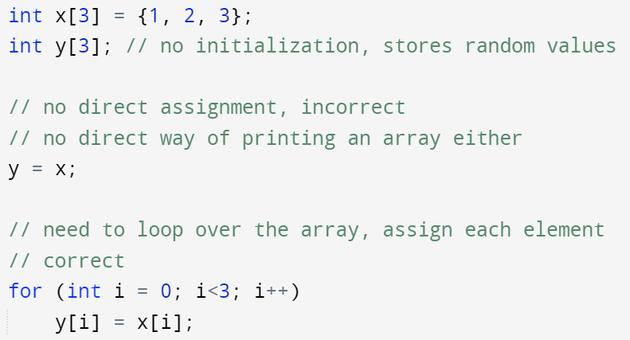
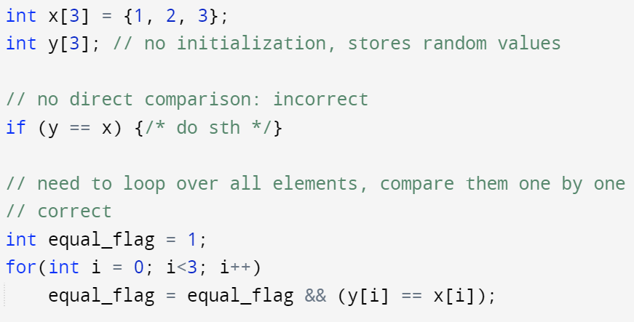
Array – comparison and assignment
Array can’t be assigned or compared directly after their declaration
We can also use functions provided by standard library to achieve assignments and comparisons (#include <string.h>)
Memcopy
memcmp

Slide 28
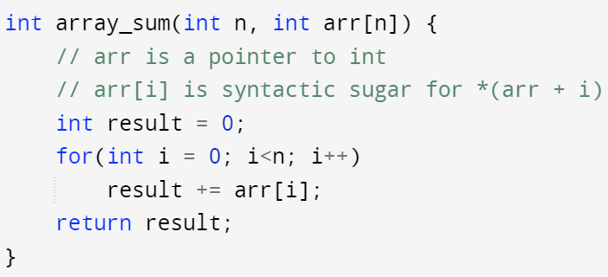
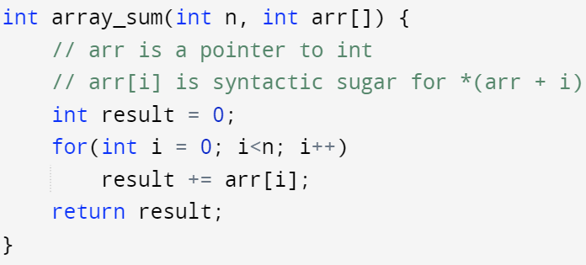
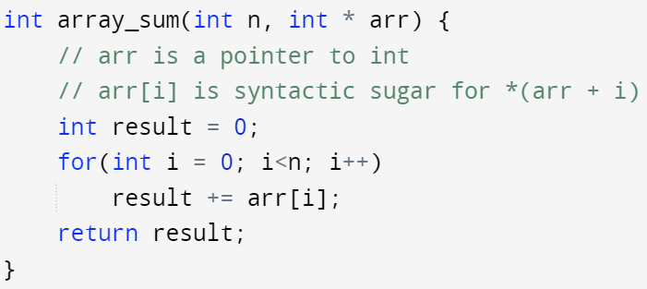
Array – as function parameters
Use pointer as formal parameter to receive actual array input
Array implicitly converts to a pointer to the array’s 1st element when passing to a function, this is also referred as “an array decays to a pointer”
Always pass the size of the array to the function
there’s no other way for the function to know the size of the input array unless (1) there’s some global size parameter or (2) passing the size of the input array as another parameter to the function
sizeof operator won’t give you the size of the input array since it’s already ‘decayed’ to a pointer
They are effective declaring the same formal parameter arr
Both 1st and 2nd version gives a hint that the actual input argument for arr is an array
The 1st version also hints that formal parameter n is denoting the size of the input array (this is not a constraint)

Slide 29
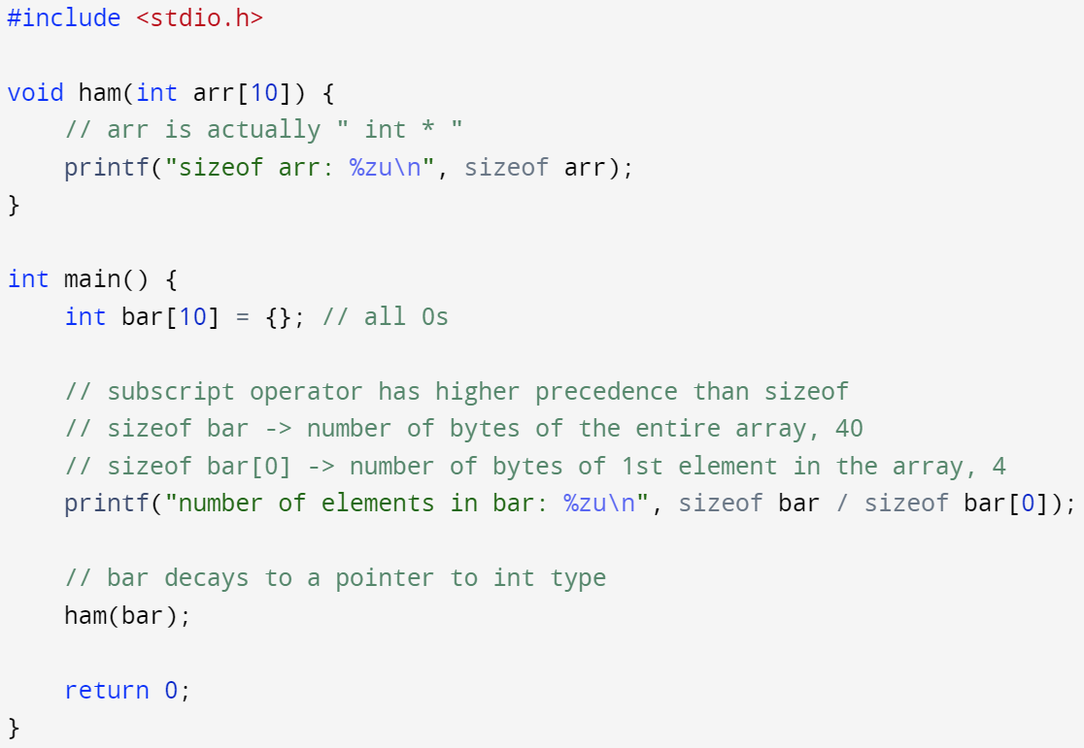

Array – as function parameters
Use pointer as formal parameter to receive actual array input
Array implicitly converts to a pointer to the array’s 1st element when passing to a function, this is also referred as “an array decays to a pointer”
Always pass the size of the array to the function
there’s no other way for the function to know the size of the input array unless (1) there’s some global size parameter or (2) passing the size of the input array as another parameter to the function
sizeof operator won’t give you the size of the input array since it’s already ‘decayed’ to a pointer

Slide 30
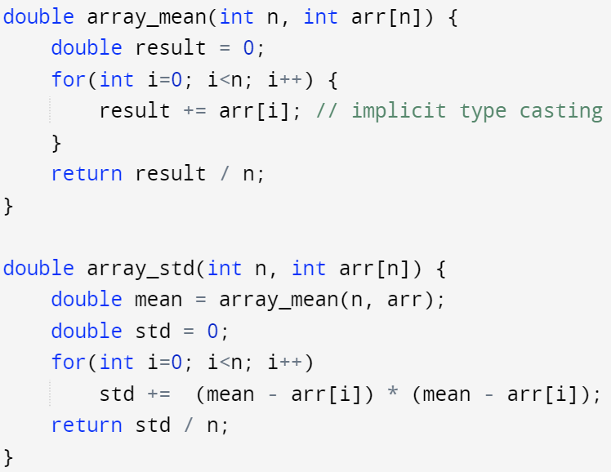
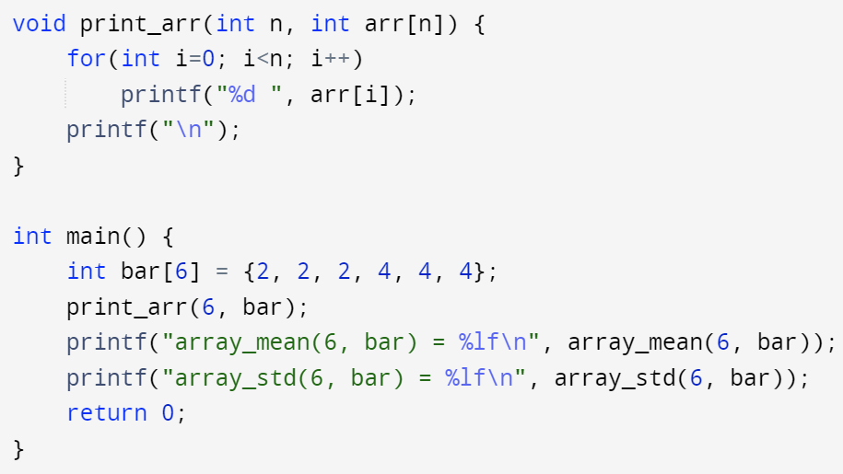
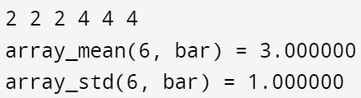
Array – as function parameters
Example

Slide 31

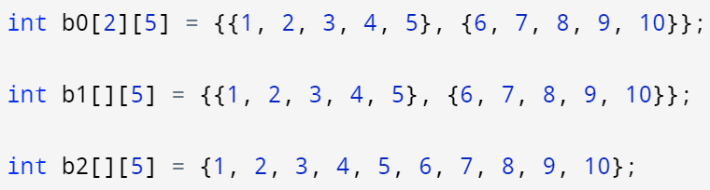
Array – nested arrays – multidimensional array
1-dimensional array, each element is primitive data type: int
2-dimensional array: a 1-dimensional array with each element being a 1-dimensional array
b0, b1, b2 are 2-d arrays storing the same values

Slide 32
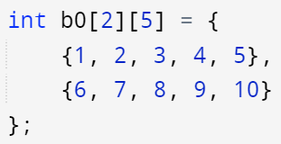
Array – nested arrays – multidimensional array
Nested arrays are still occupying a consecutive block of memory
2 elements in b0
Each element is an array of 5 int
Initializer for the 1st element
Initializer for the 2nd element
b0 in memory space:
1
2
3
4
5
6
7
8
9
10

Slide 33
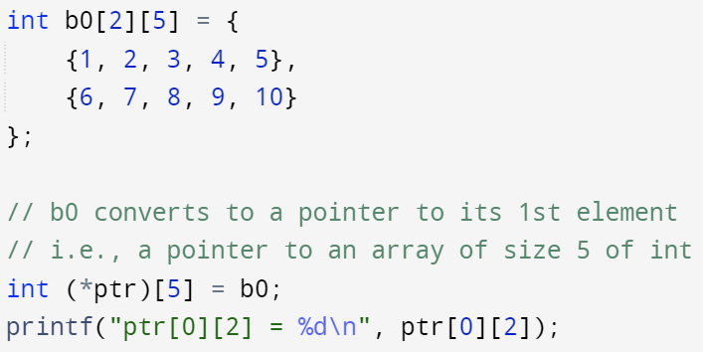


Array – nested arrays – multidimensional array
An array implicitly converts to a pointer to its 1st element unless
Being used as an operand of &
Being used as an operand of sizeof
What does a 2-d array’s identifier convert to?
The 1st element of a 2-d array is a 1-d array
A 2-d array’s identifier converts to a pointer to 1-d array of size N
N is the size of the 1-d array (in this case, N=5)
b0 in memory space:
1
2
3
4
5
6
7
8
9
10
ptr
ptr+1

Slide 34
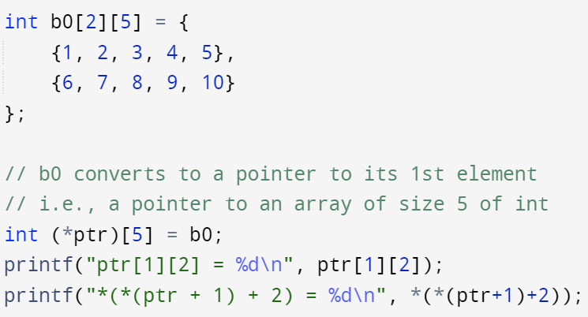

Array – pointer arithmetic
Rule of pointer arithmetic still applies to a pointer to a whole array
ptr is a pointer to an array of size 5 of int (clockwise rule)
ptr[1][2] is syntactic sugar for *( *(ptr + 1) + 2)
*(ptr + 1) will return b0[1], the 2nd element of b0, a 1-d array
Address of ptr + 1 is calculated by: ptr + 1 * sizeof(int [5])
The retrieved 1-d array decays to a pointer to its 1st element (int * anonymous)
*(anonymous + 2) will advance 2 * sizeof(int) from the base address
b0 in memory space:
1
2
3
4
5
6
7
8
9
10
ptr
ptr+1
*(ptr+1) + 2

Slide 35
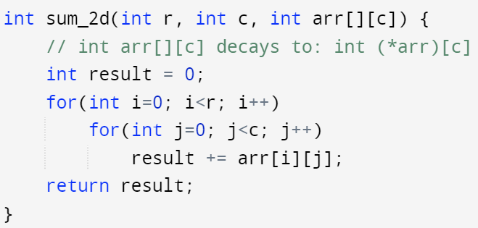
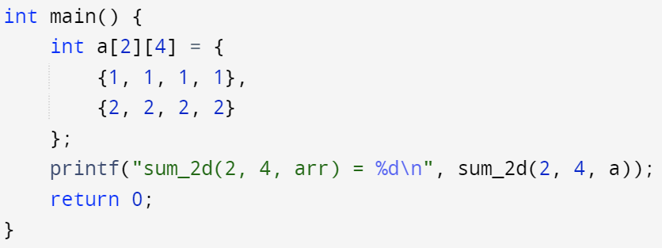
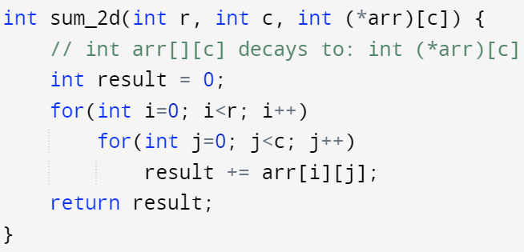

Array – nested array as function parameter
Only the first dimension’s size can be ignored in the formal parameter

Slide 36
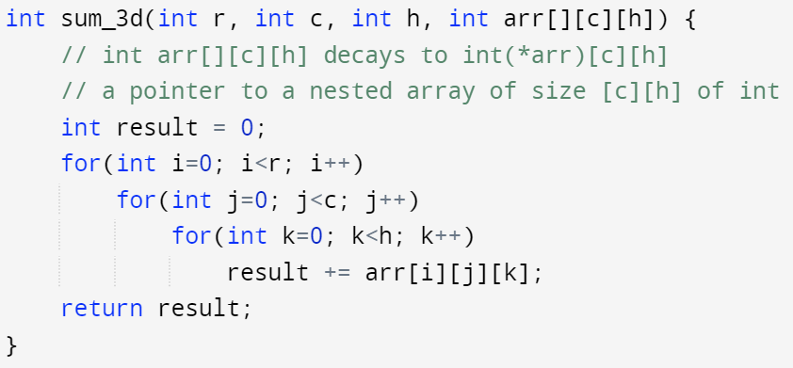
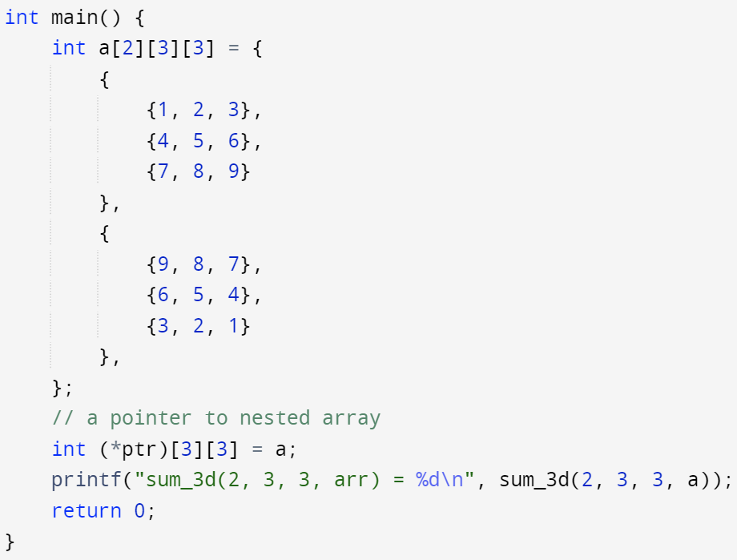
Array – multidimensional array
Array of more than 2 dimensions follows the same logic
The array’s identifier decays to a pointer to its 1st element (still a nested array)
The array’s identifier won’t decay to a pointer when used as operands for:
& (address of operator)
sizeof operator
the formal parameter for a nested array can only ignore the size of the 1st dimension of the array
Pointer arithmetic depends on the size of the pointed object

Slide 37
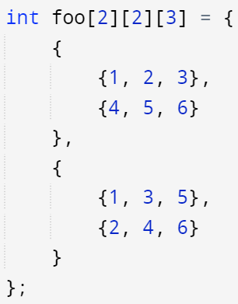
Array – multidimensional array
The reason by we can only ignore the size of the 1st dimension is related to:
The nested array are stored in a consecutive block in memory as if it is rasterized into a 1-d sequence
The pointer arithmetic operation requires knowledge of pointed (nested) array’s size
foo[0]: return int[2][3] array, decays to int (*)[2][3] pointer
foo[1]: return int[2][3] array, decays to int (*)[2][3] pointer
1
2
3
4
5
6
1
3
5
2
4
6
foo[0][1]: return int[3] array, decays to int (* )[3] pointer
foo[1][1][1]: return int value: 4

Slide 38
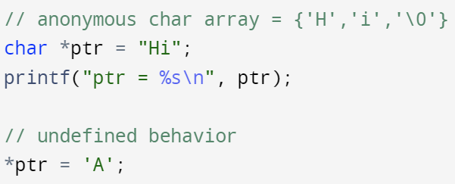

A pointer to string literal
String literal is stored somewhere in the memory as an anonymous character array
You may use a pointer to char to point to this array
You may not alter the string literal via dereference operator * (undefined behavior)
Notes:
https://stackoverflow.com/questions/2245664/what-is-the-type-of-string-literals-in-c-and-c

Slide 39

Valid main function
Main function has several valid forms
The actual input arguments to a main function is passed via command line arguments, it’s similar to passing different option flags to gcc program when compiling your source code (-Wall, -o, -g, -std, etc.)

Slide 40

Valid main function
For main function with input arguments
argc is a counter variable used to record the number of arguments passed to the program, starting with the name of the program itself as the 1st argument
argv is an array of pointers, each pointer is pointing to a string (storing your command line input)

Slide 41


Valid main function - example
My program takes command line arguments and print them as strings
Executable program named prog
without additional input
arguments are separated by whitespace(s)
with additional input

